Slide 1
Cloud Security Ameaças e Defesas
Seminário
2019
Nuno Santos

Slide 2
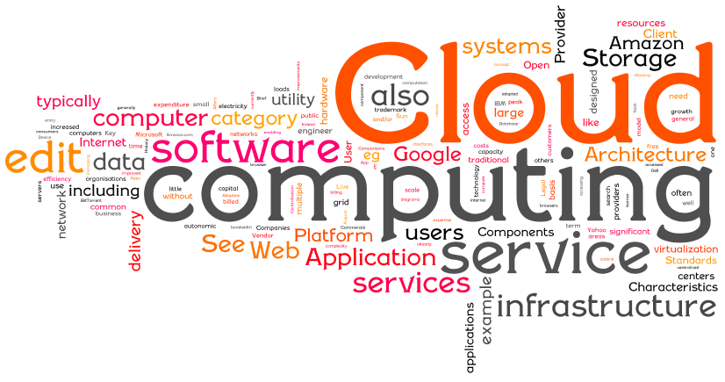
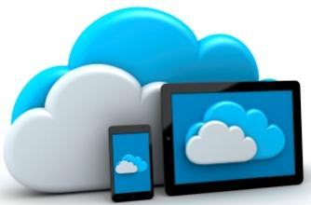
O que é a cloud?
“Cloud computing is a model for enabling convenient, on-demand network access to a shared pool of configurable resources (e.g., networks, servers, storage, applications, and services) that can be rapidly provisioned and released with minimal management effort or service provider interaction.”
NIST
Notes:
National Institute of Standards and Technology
NIST promotes U.S. innovation and industrial competitiveness by advancing measurement science, standards, and technology in ways that enhance economic

Slide 3
Principais características de cloud computing
Self-service on demand
Acesso através de rede de banda larga
Partilha de recursos (multi-tenant)
Rápida elasticidade
Monitorização do serviço
Pay per use
Cloud
Provider
Notes:
NIST definition
Measured service is a term that IT professionals apply to cloud computing. This is a reference to services where the cloud provider measures or monitors the provision of services for various reasons, including billing, effective use of resources, or overall predictive planning.

Slide 4
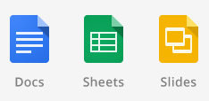


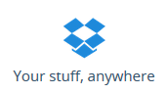





Panorama de cloud computing
Applications
Storage
Computing
Development platform

Slide 5




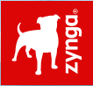






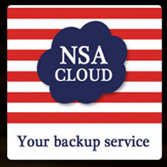
Quem utiliza cloud computing?
Notes:
Many sectors including healthcare, government, finance, retail and automobile use the cloud for file sharing, web, mobile, HPC, CRM, ERP, data storage, analytics etc.
Lot of sensitive information stored, processed and transferred on the cloud
Educational records, IRB
IP, Health
Finance
Government
Games, Entertainment etc.

Slide 6
Tendências

Slide 7
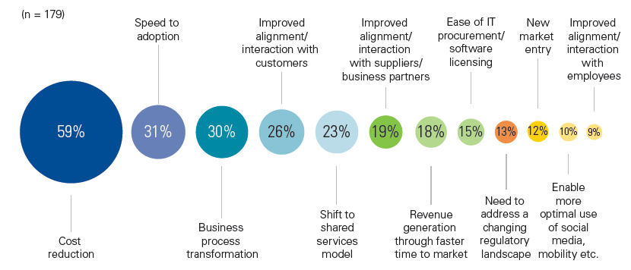
Porque é que os clientes usam a cloud?
KPMG International’s 2012 Global Cloud Provider Survey (n=179)

Slide 8
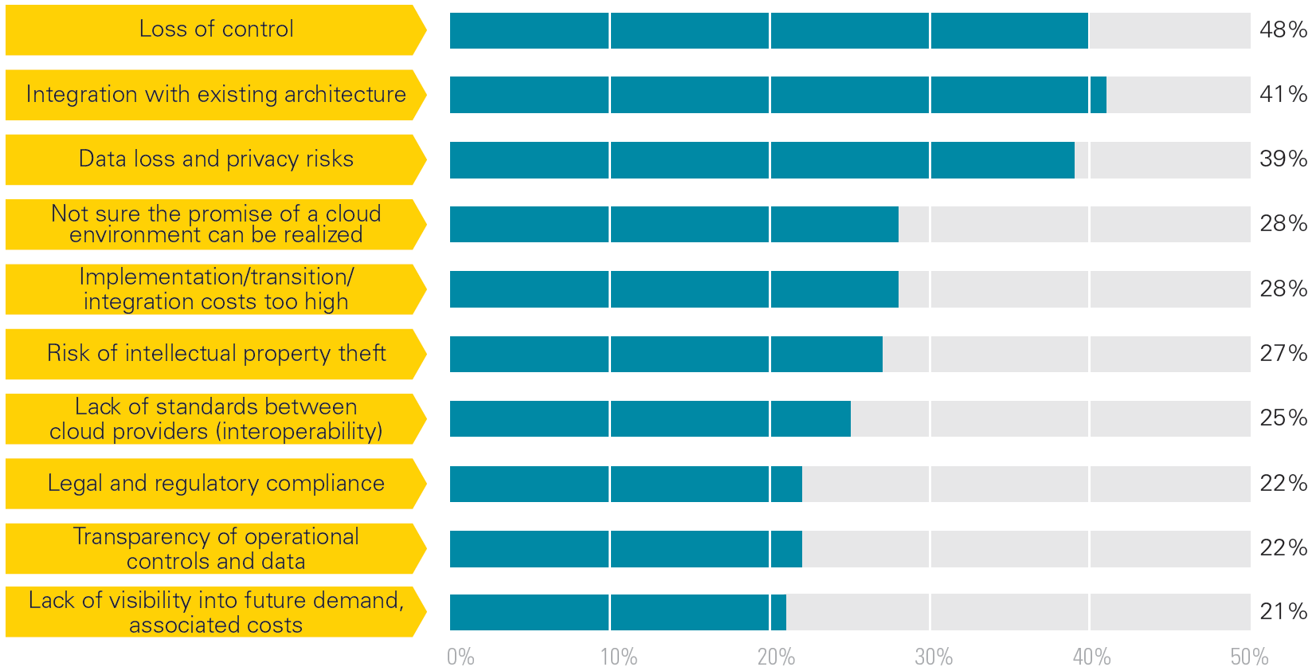
Principais preocupações de potenciais clientes
KPMG International’s 2012 Global Cloud Provider Survey (n=179)

Slide 9
Dados sensíveis na cloud: Exemplos
Aplicações hospedadas na cloud
Billing
CRM
ERP
Saúde
Dados Pessoais
Aria Systems
eVapt
nDEBIT
Redi2
Zuora
37 Signals
Capsule
Dynamics
Intouchcrm
LiveOps
Oracle CRM
Parature
Responsys
RO|Enablement
Salesforce.com
Save My Table
Solve 360
Acumatica ERP
Blue Link Elite
Epicor Express
NetSuite
OrderHarmony
Plex Online
CECity
SNO
Google Docs
Microsoft Office
Mint.com
Dados pessoais
Dados de empresas
http://cloudtaxonomy.opencrowd.com/taxonomy/
Notes:
This point is also clear if we look at examples of applications running in the cloud.
This is a sampling of applications that run fully in the cloud – or SaaS apps.
Billing, CRM, ERP: potentially sensitive corporate data
Health, Personal Data: potentially sensitive personal data

Slide 10
Neste seminário
Quais são as principais ameaças do ponto de vista segurança para quem utiliza a cloud?
Que defesas / soluções existem para mitigar essas ameaças?

Slide 11
Breve anatomia da cloud

Slide 12
Arquitectura simplificada de uma cloud

Slide 13
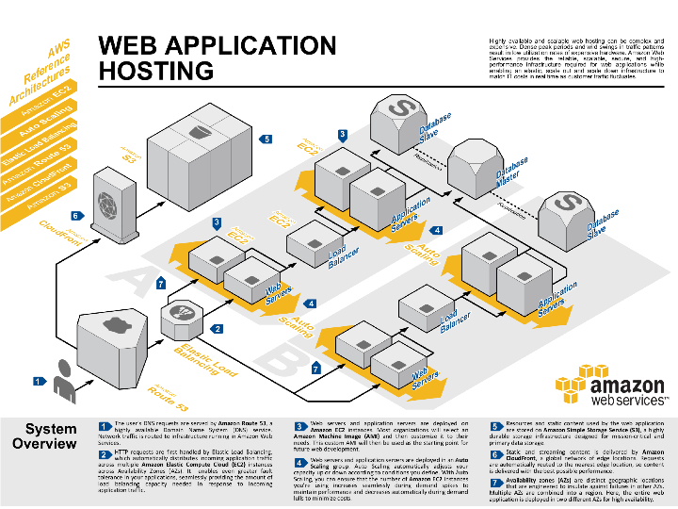
A coluna vertebral da cloud: Datacenters

Slide 14
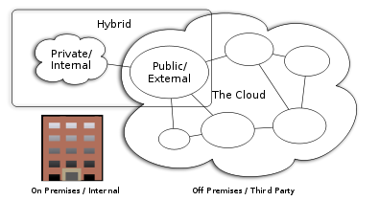
Modelos de cloud deployment
Notes:
Deployment methods for a cloud:
Public - accessible to anyone
Private - can be accessed only by people who have the necessary credentials
Community - a way to bring people together for a specific purpose
Hybrid - enables a company to keep some information private and designate other files as public or community information
What is a public cloud?
Public clouds are the most common way of deploying cloud computing. The cloud resources (like servers and storage) are owned and operated by a third-party cloud service provider and delivered over the Internet. Microsoft Azure is an example of a public cloud. With a public cloud, all hardware, software, and other supporting infrastructure is owned and managed by the cloud provider. In a public cloud, you share the same hardware, storage, and network devices with other organizations or cloud “tenants.” You access services and manage your account using a web browser. Public cloud deployments are frequently used to provide web-based email, online office applications, storage, and testing and development environments.
What is a private cloud?
A private cloud consists of computing resources used exclusively by one business or organization. The private cloud can be physically located at your organization’s on-site datacenter, or it can be hosted by a third-party service provider. But in a private cloud, the services and infrastructure are always maintained on a private network and the hardware and software are dedicated solely to your organization. In this way, a private cloud can make it easier for an organization to customize its resources to meet specific IT requirements. Private clouds are often used by government agencies, financial institutions, any other mid- to large-size organizations with business-critical operations seeking enhanced control over their environment.
https://azure.microsoft.com/en-us/overview/what-are-private-public-hybrid-clouds/
Private cloud
--The cloud is managed by an organization and serve it solely.
Public cloud
--The cloud infrastructure is owned and managed by a large Cloud Service Provider (CSP).
Community cloud
--The cloud is managed by several organizations and supports a specific community that has the same interest.
Hybrid cloud
-- The cloud infrastructure is composed of two or more of the above models

Slide 15
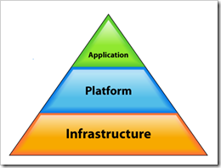
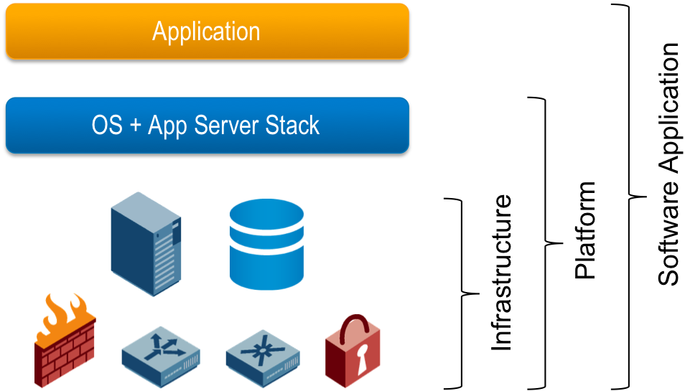
Modelos de cloud service delivery
Notes:
http://onsaas.net/2008/06/03/defining-saas-paas-iaas-etc/

Slide 16
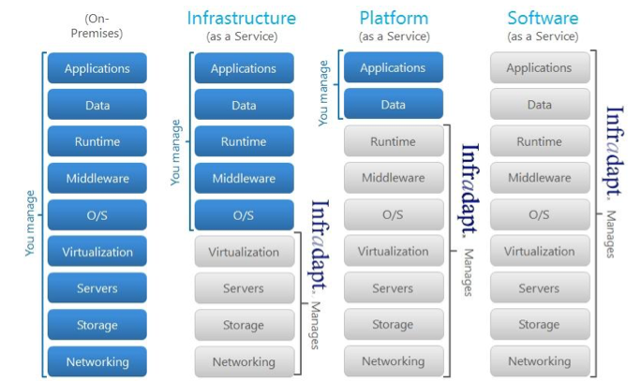
Modelos de cloud service delivery
Três modelos principais: IaaS, PaaS, and SaaS
“You” – o cliente cloud; “Infradapt” – o provedor de serviço cloud
Notes:
Software as a service (SaaS) - applications are delivered via the Internet
Platform as a service (PaaS) - an OS, such as Linux or Windows, has been installed on a cloud server
Infrastructure as a service (IaaS) - customers can rent hardware and install whatever OSs and applications they need

Slide 17
Virtualização muito disseminada na cloud

Slide 18
Hypervisors
Runs multiple instances of an OS (or multiple OSes) on shared hardware
Native or “bare metal”
PR/SM on the IBM System 370 (1972!)
VMWare ESXi
Microsoft Hyper-V
Host based
Virtual PC
VMWare Server
Parallels
Can use direct physical storage and/or virtual disks
Mainly used for IaaS and PaaS

Slide 19
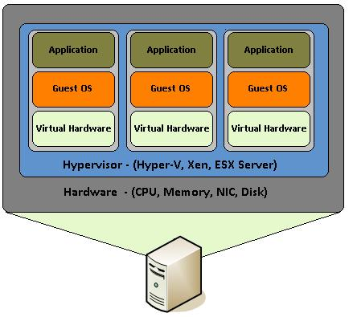
Native Hypervisor

Slide 20
Virtualização muito usada na cloud
Permite particionar recursos entre utilizadores / aplicações; garante isolamento
Notes:
http://www1.cse.wustl.edu/~jain/cse571-09/ftp/vmsec/index.html

Slide 21
Principais riscos e ameaças

Slide 22
Threat Model
Risk 1: Resource Exhaustion*
Risk 2: Customer Isolation Failure*
Risk 3: Management Interface Compromise
Risk 4: Interception of Data in Transmission
Risk 5: Data leakage on Upload/Download, Intra-cloud

Slide 23
Threat Model
Risk 6: Insecure or Ineffective Deletion of Data*
Risk 7: Distributed Denial of Service (DDoS)
Risk 8: Economic Denial of Service*
Risk 9: Loss or Compromise of Encryption Keys
Risk 10: Malicious Probes or Scans

Slide 24
Threat Model
Risk 11: Compromise of Service Engine/Hypervisor*
Risk 12: Conflicts between customer hardening procedures and cloud environment
Risk 13: Subpoena and E-Discovery*
Risk 14: Risk from Changes of Jurisdiction*
Risk 15: Licensing Risks*

Slide 25
Threat Model
Risk 16: Network Failure
Risk 17: Networking Management
Risk 18: Modification of Network Traffic
Risk 19: Privilege Escalation*
Risk 20: Social Engineering Attacks

Slide 26
Threat Model
Risk 21: Loss or Compromise of Operation Logs
Risk 22: Loss or compromise of Security Logs
Risk 23: Backups Lost or Stolen
Risk 23: Unauthorized Access to Premises, Including Physical Access to Machines and Other Facilities
Risk 25: Theft of Computer Equipment.*

Slide 27
Mesmos problemas de segurança de sempre
Data Loss
Downtimes
Phishing
Password Cracking
Botnets and Other Malware

Slide 28
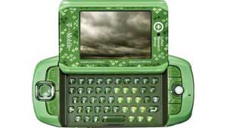
Data Loss
"Regrettably, based on Microsoft/Danger's latest recovery assessment of their systems, we must now inform you that personal information stored on your device—such as contacts, calendar entries, to-do lists or photos—that is no longer on your Sidekick almost certainly has been lost as a result of a server failure at Microsoft/Danger."
Notes:
http://arstechnica.com/business/news/2009/10/t-mobile-microsoftdanger-data-loss-is-bad-for-the-cloud.ars

Slide 29
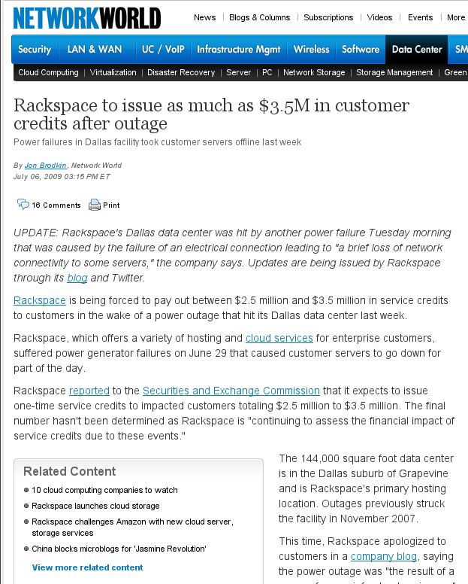
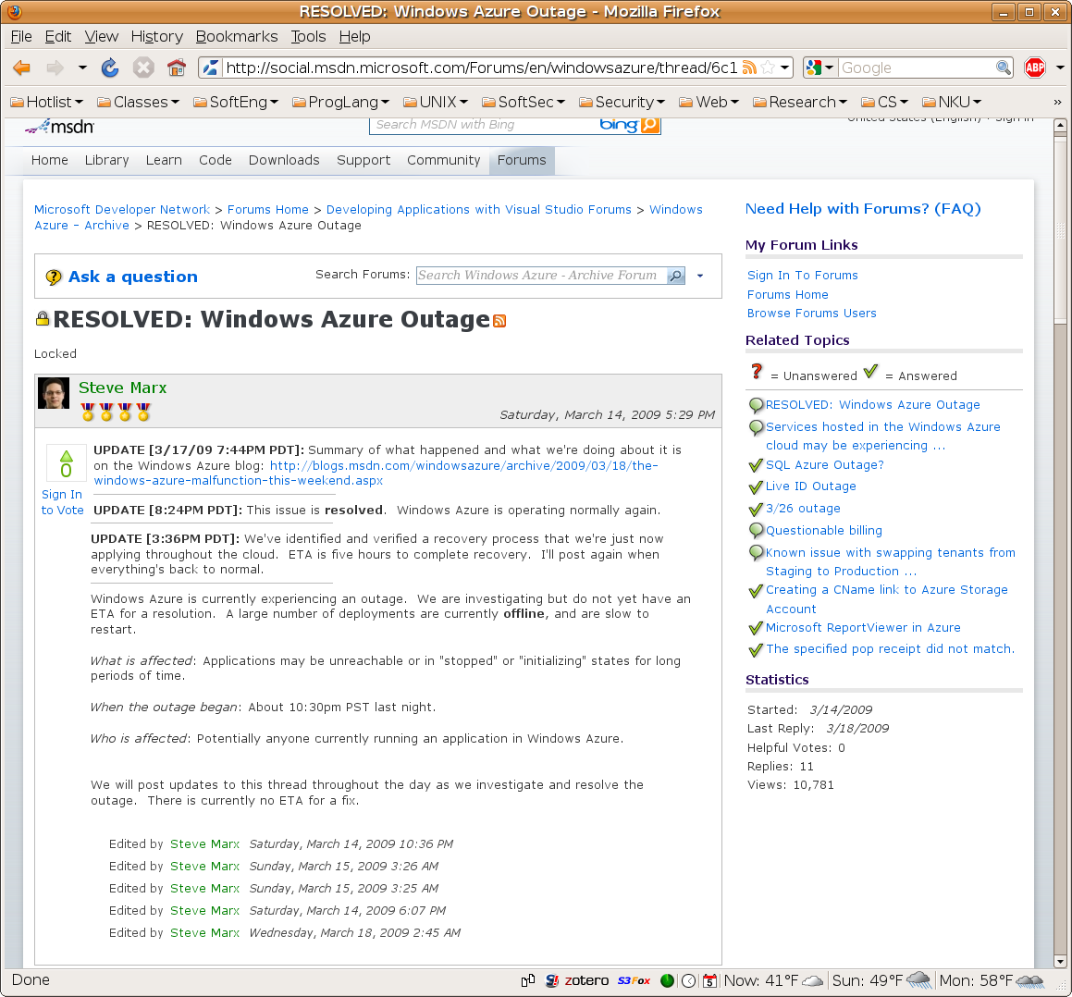
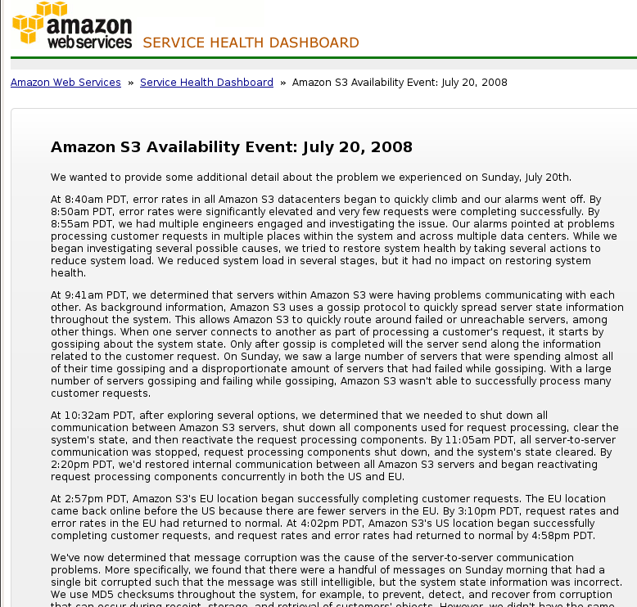
Downtimes

Slide 30
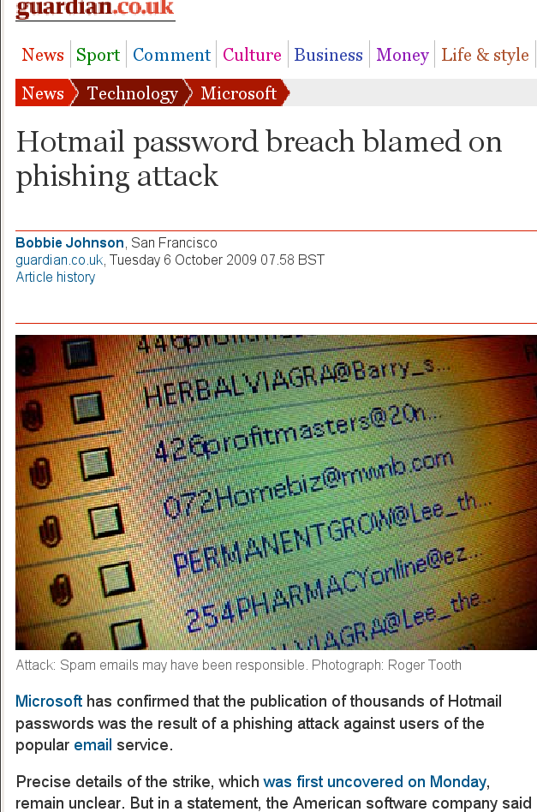
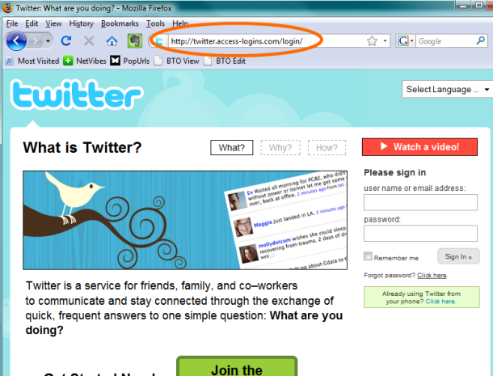
Phishing
“hey! check out this funny blog about you...”
Notes:
http://news.cnet.com/twitter-phishing-scam-may-be-spreading/

Slide 31
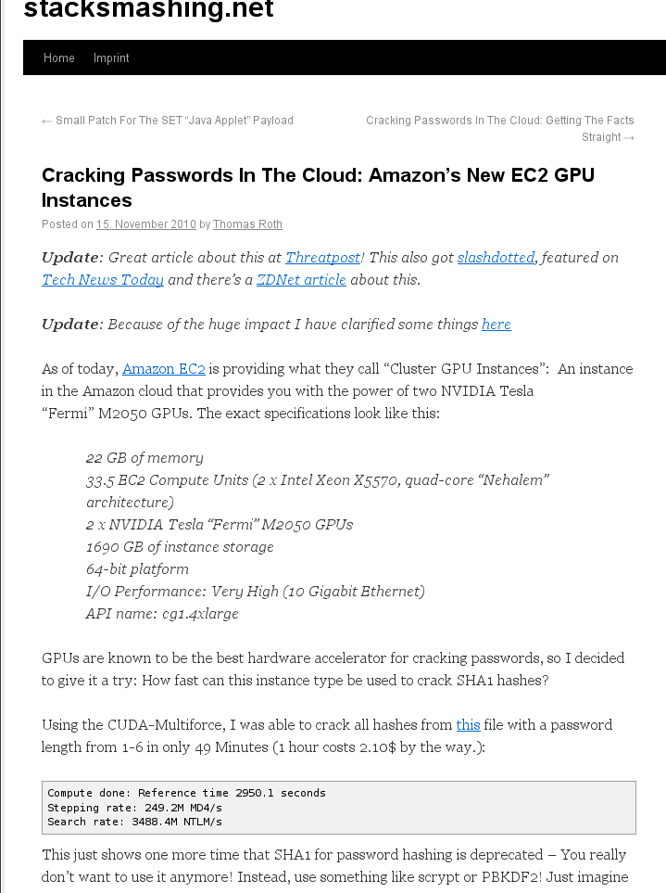
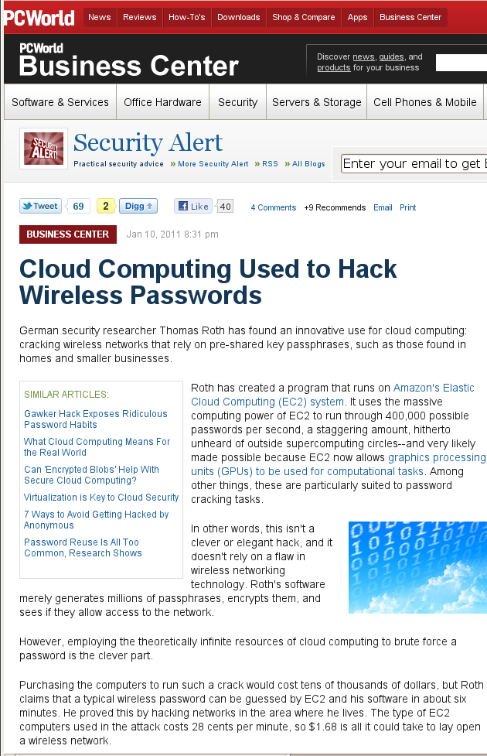
Password Cracking

Slide 32
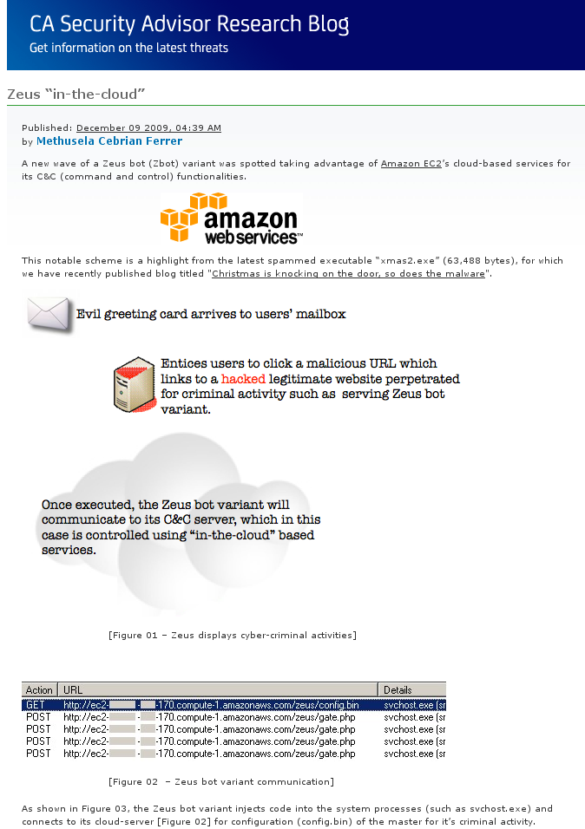
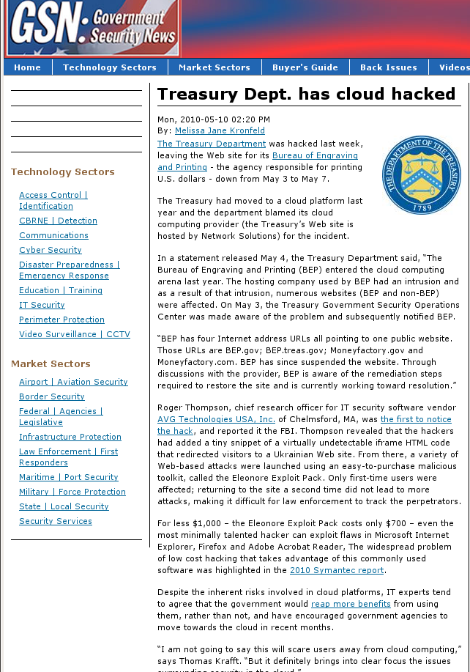
Botnets and Malware
Notes:
http://community.ca.com/blogs/securityadvisor/archive/2009/12/09/zeus-in-the-cloud.aspx

Slide 33
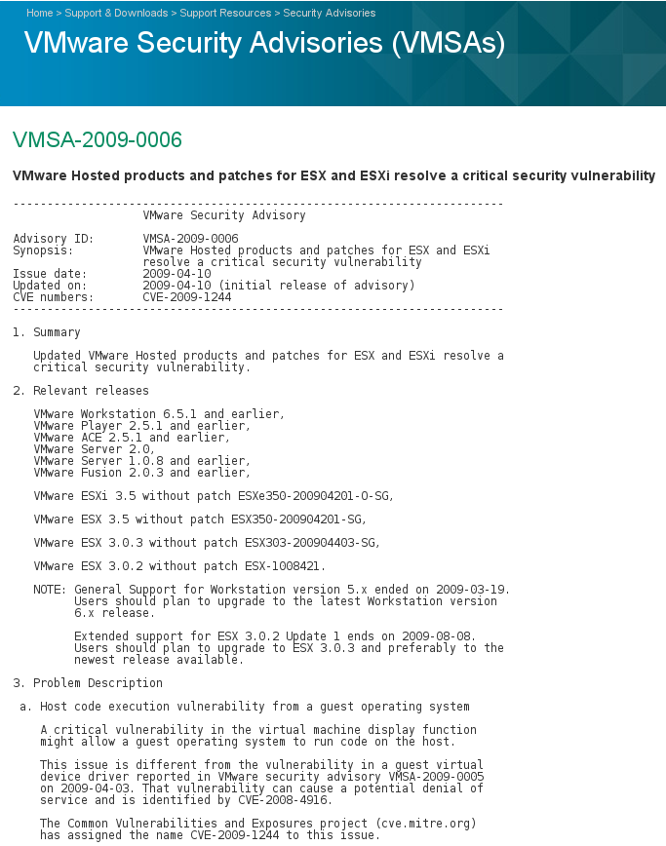
Hypervisor Security
Vulnerability consequences
Guest code execution with privilege
VM Escape (Host code execution)
Vendor | CVEs
KVM | 32
QEMU | 23
VirtualBox | 9
VMware | 126
Xen | 86
Xen CVE-2008-1943
VBox CVE-2010-3583

Slide 34
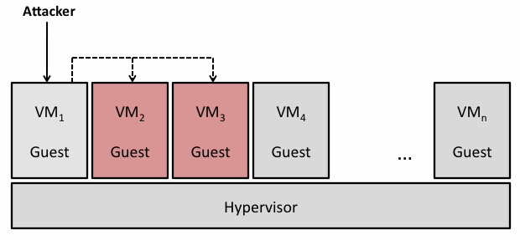
Inter-VM Attacks
Attack via shared clipboard
http://www.securiteam.com/securitynews/5GP021FKKO.html
Use shared folder to alter other VM’s disk image
CVE-2007-1744
Notes:
http://www1.cse.wustl.edu/~jain/cse571-09/ftp/vmsec/index.html

Slide 35
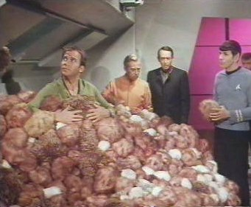
Scaling
Growth in physical machines limited by budget and setup time.
Adding a VM is easy as copying a file, leading to explosive growth in VMs.
Rapid scaling can exceed capacity of organization’s security systems.

Slide 36
Transience
Users often have specialized VMs.
Testing
Different app versions
Demos
Sandbox
that are not always up, preventing network from converging to a known state.
Infected machines appear, attack, then disappear from the network before can be detected.
Vulnerable systems likewise appear too briefly to be detected and patched.

Slide 37
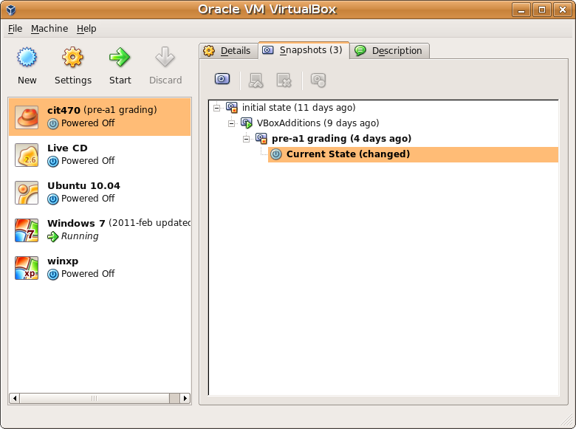
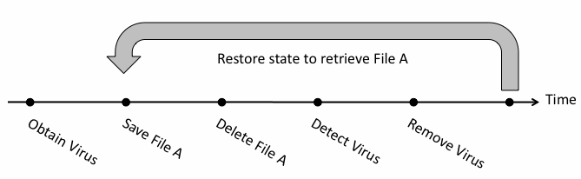
Data Lifetime
Although data was correctly sanitized from VM disk and/or memory, snapshots can retain multiple copies of both VM memory and disk data.

Slide 38
Novos problemas de segurança
Accountability
No Security Perimeter
Larger Attack Surface
New Side Channels
Lack of Auditability
Regulatory Compliance
Data Security

Slide 39
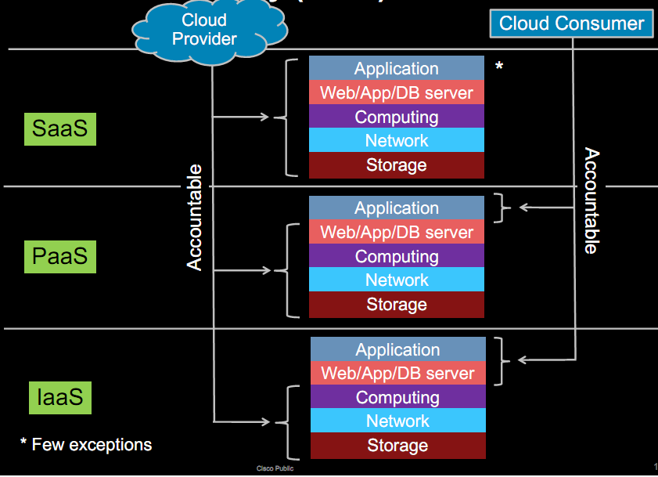
Accountability

Slide 40

No Security Perimeter
Little control over physical or network location of cloud instance VMs
Network access must be controlled on a host by host basis.

Slide 41
Larger Attack Surface
Cloud Provider
Your Network

Slide 42
New Side Channels
You don’t know whose VMs are sharing the physical machine with you.
Attackers can place their VMs on your machine.
See “Hey, You, Get Off of My Cloud” paper for how.
Shared physical resources include
CPU data cache: Bernstein 2005
CPU branch prediction: Onur Aciiçmez 2007
CPU instruction cache: Onur Aciiçmez 2007
In single OS environment, people can extract cryptographic keys with these attacks.

Slide 43
Lack of Auditability
Only cloud provider has access to full network traffic, hypervisor logs, physical machine data.
Need mutual auditability
Ability of cloud provider to audit potentially malicious or infected client VMs.
Ability of cloud customer to audit cloud provider environment.

Slide 44
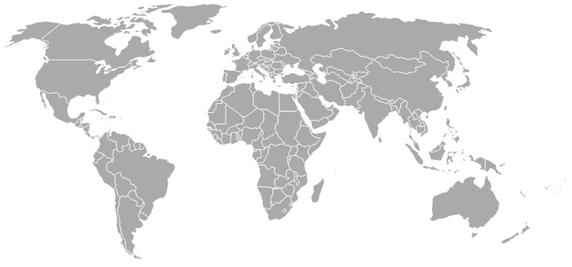
Regulatory Compliance

Slide 45
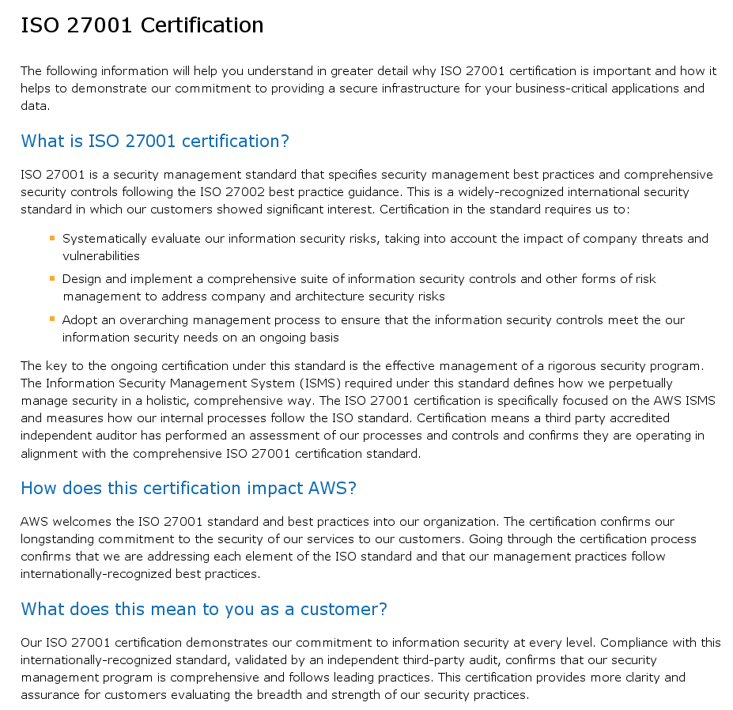
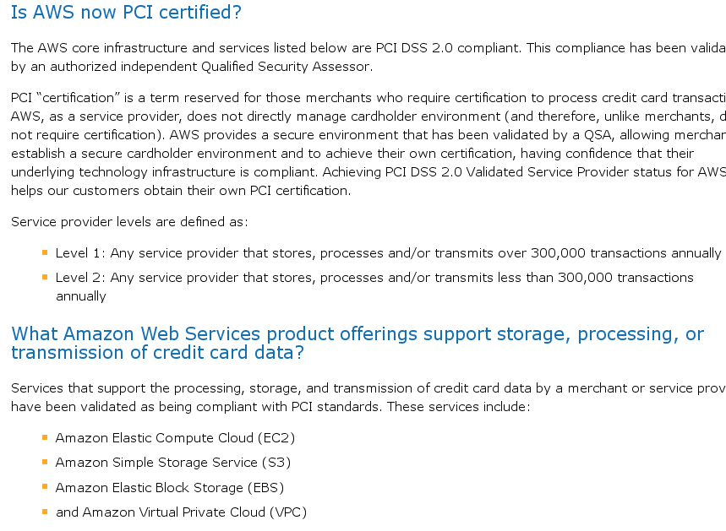
Certifications

Slide 46
Soluções de segurança na cloud

Slide 47
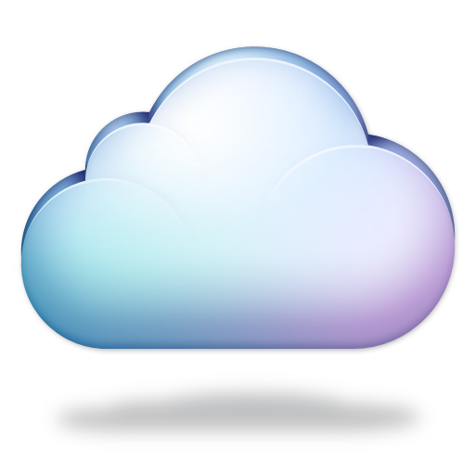
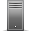
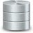


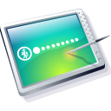
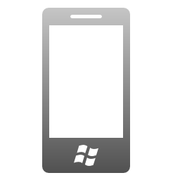
Um problema de segurança particularmente difícil
Dados na cloud vulneráveis a:
Administradores curiosos
Piratas com acesso ilegal
Servidores comprometidos
Notes:
These benefits come with some drawbacks.
Particularly security concerns.
[Slide]

Slide 48
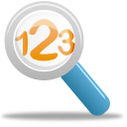

Abordagem natural: Encriptação de dados
a7be1a6997ad739bd8c9ca451f618b61
b6ff744ed2c2c9bf6c590cbf0469bf41
47f7f7bc95353e03f96c32bcfd8058df
Encr
Key
The quick brown fox jumps over the lazy dog
Notes:
A natural approach to securing the data in the cloud is encryption.
We keep data in the cloud encrypted.
Idea: the adversary can snoop at this data but cannot learn anything without the key used to encrypt the data which is ideally not stored in the cloud

Slide 49
Recomendação de segurança da Amazon AWS
7.2. Security. We strive to keep Your Content secure, but cannot guarantee that we will be successful at doing so, given the nature of the Internet. Accordingly, without limitation to Section 4.3 above and Section 11.5 below, you acknowledge that you bear sole responsibility for adequate security, protection and backup of Your Content. We strongly encourage you, where available and appropriate, to use encryption technology to protect Your Content from unauthorized access and to routinely archive Your Content. We will have no liability to you for any unauthorized access or use, corruption, deletion, destruction or loss of any of Your Content.
Source: http://aws-portal.amazon.com/gp/aws/developer/terms-and-conditions.html

Slide 50
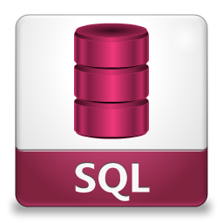
E se os dados estiverem em bases de dados?
Que implicações tem a encriptação de dados em termos de funcionalidade?
Notes:
So far our discussion on data confidentiality has been generic
Now we focus on db-as a service and the implications of using encryption as a technology
Most basic question: what does it mean in terms of functionality?

Slide 51
Exemplo: Base de dados de curso online
Student
StudentId | Name | Addr | GPA | CreditCard | …
Course
CourseId | Name | InstrId | …
StudentCourse
CourseId | StudentId | Grade | …
Notes:
At this point, introduce a running example: backend database for a hypothetical online course systems (e.g., Coursera).
Contains sensitive attributes shown circled.
GPA: grade point average, or GPA

Slide 52
Encriptação e bases de dados: Funcionalidade
SELECT *
FROM courses
WHERE StudentId = 1234
Client App
Notes:
Plaintext functionality

Slide 53
Encriptação e bases de dados: Funcionalidade
Encrypted
SELECT *
FROM courses
WHERE StudentId = 1234
Client App
Notes:
Desired functionality under encryption: encrypted data stored, encrypted queries, and encrypted results

Slide 54

Adversário passivo
Passivo
Honesto mas curioso
Não altera:
Base de dados
Resultados
E para adversários activos?
Notes:
To understand security, we need to model powers of the adversary. This tutorial: passive adversary

Slide 55
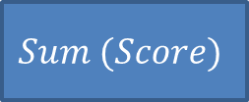
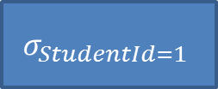
Encriptação: Um desafio de fundo
$$Sum (Score)$$
Select Sum (Score)
From Assignment
Where StudentId = 1
$$σ_{StudentId=1}$$
StudentId | AssignId | Score
1 | 1 | 68
1 | 2 | 71
3 | 4 | 99
… | … | …

Slide 56
Encriptação: Um desafio de fundo
$$Sum (Score)$$
Select Sum (Score)
From Assignment
Where StudentId = 1
$$σ_{StudentId=1}$$
Assignment
a7be1a6997ad739bd8c9ca451f618b61
b6ff744ed2c2c9bf6c590cbf0469bf41
47f7f7bc95353e03f96c32bcfd8058df
Notes:
Encryption “hides” data, so traditional query processing does not work in an obvious way

Slide 57
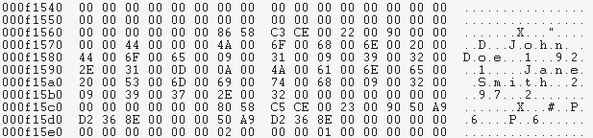
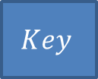
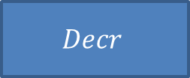
Encriptação: Um desafio de fundo
$$Sum (Score)$$
Select Sum (Score)
From Assignment
Where StudentId = 1
$$σ_{StudentId=1}$$
Memory
$$Decr$$
$$Key$$
Assignment
Storage
a7be1a6997ad739bd8c9ca451f618b61
b6ff744ed2c2c9bf6c590cbf0469bf41
47f7f7bc95353e03f96c32bcfd8058df
Notes:
Decrypt the data-on-the-fly?
Two problems: key is in the cloud
Plaintext data is visible at least for sometime
Most of the talk: working definition of security == data remains encrypted everywhere including memory at all times

Slide 58
Espectro de soluções
Duas abordagens fundamentais:
Computar directamente sobre dados cifrados
Computar os dados num ambiente seguro
Notes:
Special homomorphic encryption schemes
Challenge: limited class of computations
Challenge: Not composable
Computations on plaintextChallenge: Expensive

Slide 59
Como cifrar a base de dados?
Encr
Cell granularity
E ainda assim, permitir a realização de operações sobre os dados sem ter que os decifrar?

Slide 60
Esquema criptográfico (chave simétrica)
Key:
000102030405060708090a0b0c0d0e0f
Plaintext
Ciphertext
Encr
a7be1a6997ad739bd8c9ca451f618b61
b6ff744ed2c2c9bf6c590cbf0469bf41
47f7f7bc95353e03f96c32bcfd8058df
The quick brown fox jumps over the lazy dog
Ciphertext
Plaintext
a7be1a6997ad739bd8c9ca451f618b61
b6ff744ed2c2c9bf6c590cbf0469bf41
47f7f7bc95353e03f96c32bcfd8058df
Decr
The quick brown fox jumps over the lazy dog
Key:
000102030405060708090a0b0c0d0e0f
Notes:
Encryption scheme – encryption function, decryption function. Given a key the encryption function maps input to seemingly random sequence of bytes. Given the key the decryption function, gets back the original input.

Slide 61
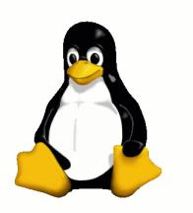
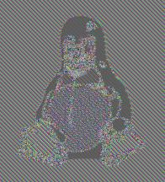

Segurança forte implica não determinismo
Original
Deterministic
Non-Deterministic
Source: http://en.wikipedia.org/wiki/Block_cipher_modes_of_operation

Slide 62
Esquema de encriptação não determinista
Key:
000102030405060708090a0b0c0d0e0f
Encr
a7be1a6997ad739bd8c9ca451f618b61
b6ff744ed2c2c9bf6c590cbf0469bf41
47f7f7bc95353e03f96c32bcfd8058df
The quick brown fox jumps over the lazy dog
000102030405060708090a0b0c0d0e0f
Encr
fa636a2825b339c940668a3157244d17
247240236966b3fa6ed2753288425b6c
69c4e0d86a7b0430d8cdb78070b4c55a
The quick brown fox jumps over the lazy dog
Example: AES + CBC + variable IV
Notes:
Implication: we cannot even determine if two ciphertexts came from the same plaintext

Slide 63
Esquema de encriptação determinista
Key:
000102030405060708090a0b0c0d0e0f
Encr
a7be1a6997ad739bd8c9ca451f618b61
b6ff744ed2c2c9bf6c590cbf0469bf41
47f7f7bc95353e03f96c32bcfd8058df
The quick brown fox jumps over the lazy dog
000102030405060708090a0b0c0d0e0f
Encr
a7be1a6997ad739bd8c9ca451f618b61
b6ff744ed2c2c9bf6c590cbf0469bf41
47f7f7bc95353e03f96c32bcfd8058df
The quick brown fox jumps over the lazy dog
Example: AES + ECB

Slide 64
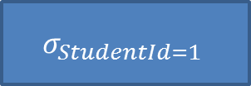
Usando encriptação determinista
select *
from assignment
where studentid = 1
$$σ_{StudentId=1}$$
StudentId | AssignId | Score
1 | 1 | 68
1 | 2 | 71
3 | 4 | 99
… | … | …
Notes:
Why deterministic encryption?

Slide 65
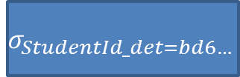
Usando encriptação determinista
select *
from assignment
where studentid_det = bd6e7c3df2b5779e0b61216e8b10b689
$$σ_{StudentId_det=bd6…}$$
StudentId_DET | AssignId | Score
bd6e7c3df2b5779e0b61216e8b10b689 | 1 | 68
bd6e7c3df2b5779e0b61216e8b10b689 | 2 | 71
7ad5fda789ef4e272bca100b3d9ff59f | 4 | 99
… | … | …
E se quiseremos somar as notas?

Slide 66
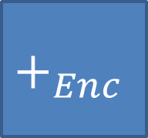


Encriptação homomórfica
$$Enc (1)$$
7ad5fda789ef4e272bca100b3d9ff59f
$$+_{Enc}$$
7a9f102789d5f50b2beffd9f3dca4ea7
bd6e7c3df2b5779e0b61216e8b10b689
$$Enc (2)$$
$$Enc (1)$$
A chave de encriptação não é um input
Notes:
Homomorphic encryption: directly compute on encrypted values
Which brings us to the general idea of homomorphic encryption. Homomorphic encryption – special encryption that lets us do some computation directly on encrypted values. The remaining encryption schemes are all examples of homomorphic encryption schemes.

Slide 67





Esquemas de encriptação homomórfica
Fully Homomorphic Encryption
(Any function)
Order-Preserving Encryption
$$(≤)$$
Paillier Cryptosystem
$$(+)$$
ElGamal Cryptosystem
$$(×)$$
Deterministic Encryption
$$(==)$$
Non-Deterministic Encryption
$$(∅)$$
Notes:
Common homomorphic encryption schemes and what can be computed using them.
Non-deterministic encryption -> no computation

Slide 68
Esquemas de encriptação homomórfica
Fully Homomorphic Encryption
(Any function)
Partial Homomorphic Encryption
Order-Preserving Encryption
$$(≤)$$
Paillier Cryptosystem
$$(+)$$
ElGamal Cryptosystem
$$(×)$$
Deterministic Encryption
$$(==)$$
Non-Deterministic Encryption
$$(∅)$$
Notes:
In the middle -> encryption schemes that allow some computation -> PHE
Top -> fully homomorphic encryption

Slide 69
Esquemas de encriptação homomórfica
Impraticável
Fully Homomorphic Encryption
(Any function)
Partial Homomorphic Encryption
Order-Preserving Encryption
$$(≤)$$
Paillier Cryptosystem
$$(+)$$
ElGamal Cryptosystem
$$(×)$$
Deterministic Encryption
$$(==)$$
Muito caro
Non-Deterministic Encryption
$$(∅)$$
Praticável
Notes:
In the middle -> encryption schemes that allow some computation -> PHE
Top -> fully homomorphic encryption

Slide 70

Esquemas de encriptação homomórfica: Performance
Scheme | Space for 1 integer (bits) | Time for 1 operation
 | $$2^{14}$$ | Cosmic time scales
 | $$2048$$ | $≈$ms
 | $$128$$ | $≈ µ$s
Fully Homomorphic Encryption
Paillier ElGamal
Deterministic Order-preserving

Slide 71
Como cifrar a nossa base de dados?
Non-deterministic
Deterministic
Plaintext
Id | SSN | Name | Score
Id | SSN_DET | Name_NDET | Score_OPE
Esquema de encriptação Mix n Match

Slide 72
Um sistema representativo: CryptDB
Client
App
PlainText Query
PlainText Results
Rewritten Query
DBMS +
UDFs
Web
Proxy
Key
Encrypted Data
Web proxy reescreve as queries, e decifra o resultado
Utiliza técnicas de encriptação parcialmente homomórfica
https://css.csail.mit.edu/cryptdb/
Notes:
We discuss CryptDB which uses P.H.E – we highlight certain aspects relevant to query processing, for a more detailed discussion refer to [PRZ+11].
UDF- user defined funcions

Slide 73


Processamento das queries
Client
App
DBMS +
UDFs
Web
Proxy
Key
students(ID_DET, grade_OPE, grade_PAILLIER)
Notes:
Example queries issued by the client and corresponding query fragments at the DBMS and the web-proxy.

Slide 74
Limitações encriptação parcialmente homomórfica
PHE não é de “borla” – overheads de espaço
Para Paillier, um inteiro (32 bits) resulta em ciphertext de 2048 bits!
PHE é por natureza limitado – não suporta todo SQL
Tradeoffs funcionalidade e segurança
Overheads em termos de desempenho
Notes:
While P.H.E schemes like paillier have significant storage overheads, there is recent work [GZ07] that aims to optimize this overhead. However, such schemes are for static databases and do not work for updates.

Slide 75
Espectro de soluções
Duas abordagens fundamentais:
Computar directamente sobre dados cifrados
Computar os dados num ambiente seguro
Notes:
Special homomorphic encryption schemes
Challenge: limited class of computations
Challenge: Not composable
Computations on plaintextChallenge: Expensive

Slide 76

Processamento seguro na cloud
Inaccessible
Low bandwidth High latency
Inaccessible
Notes:
Drawbacks of the client: Low b/w and high latency
Idea: Fix the limitations if we can locate the trusted module in the cloud servers. [NEXT slide]

Slide 77
Processamento seguro na cloud c/ hw seguro
Hardware Seguro
(Trusted Module)
Inacessível
Admin curioso Pirata malicioso
Inacessível
Notes:
We need to architect a database system for QPED using a trusted module.
What is a trusted module and how we can secure it from an adversary.
How to use the trusted module for query processing.
Start off with (1)
Recall adversary:

Slide 78

Ideia chave: Isolamento
OS
DBMS
Embedded OS
Commodity h/w
Secure h/w

Slide 79


Algumas tecnologias de hardware seguro
Co-processador seguro
ATMs, smart cards
Hardware Security Modules
Cripto-aceleração tamper-proof
FPGAs
Para uso militar
Chips TPM
Laptops, etc.
IBM 4764 PCI-X Cryptographic Coprocessor
Secure FPGA
Notes:
In fact, specially designed secure hardware has a long history of use for security
Secure co-processors are used in ATMs, smart cards
Hardware security modules are tamper proof hardware supporting some crypto functions and are already available in some cloud providers for encryption key management
FPGAs are widely used by the military for securing control and information systems
TPM chips present in most laptops is another example

Slide 80

TrustedDB: Baseado em co-processadores
Sensitive columns
SELECT SUM(l_extendedprice * l_discount) as revenue FROM lineitem
WHERE l_shipdate >= ‘1993-01-01’ AND
l_shipdate < ‘1994-01-01’ AND
l_discount between 0.05 and 0.07 AND l_quantity < 24
MySQL
PCI
SQLite
Embedded OS
OS
Storage
Commodity h/w
Secure Co-Processor
Intel Xeon E5: 10 x 3.6 GHz
IBM 4765: 2 x 400 MHz
60 GB RAM, etc
128 MB DRAM, 64 MB Flash
Notes:
To illustrate how query processing works consider the query:
Columns in red are sensitive, columns in green are not – can be kept in plaintext

Slide 81

Tecnologia mais recente: Intel SGX
Novo modo do processador: enclave
Aplicação pode criar um ambiente de execução protegido assegurado por HW, inacessível ao OS
Aplicação apenas precisa confiar na Intel e na implementação SGX

Slide 82

Intel SGX: Exemplo em runtime
App tem componentes trusted e untrusted
App cria enclave, enclave é área de memória protegida por CPU, e OS não pode aceder
App chama a parte trusted, e executa-se em ambiente protegido
Dados no enclave em plaintext, não podem ser acedidos de fora e vão ser cifrados logo que saiam do enclave
App termina a tarefa do enclave e retorna
App continua em ambiente comum

Slide 83


Intel SGX, isolated execution
Aplication mantém os dados e código dentro do enclave
Menor superfície de ataque possível (aplicação + processor)
System Memory
CPU Package
Enclave
Access from
OS/VMM
Memory
Encryption
Engine (MEE)
Encrypted
code/data
Snooping

Slide 84
Já suportado pelos serviços da MS Azure
Untrusted - CSP Environment
Azure Confidential Cloud &
Data Provider
Encrypted Data
Trusted – Intel® SGX enclave
Protected
Application
Protected Input Data
Encrypted Results
Secrets
Ex. SSN, City, Credit Card Number
Notes:
Protects against SW attacks even if OS/drivers/ BIOS/VMM/SMM are compromised
Smallest possible Trusted Compute Block (TCB)
Secrets (data/keys/et al) remain protected even when attacker has full control of platform
Other technologies allow some privileged SW in their boundary
Prevents attacks like memory bus snooping, memory tampering, and “cold boot” attacks against memory contents in RAM
Protection for hard-to-protect or unprotected spaces
Provides hardware-based attestation capabilities to measure and verify valid code and data signatures
Increases transparency and accountability

Slide 85
MS Azure e TEEs baseados em SGX

Slide 86
Conclusões
Bitcoin é um sistema de criptomoeda revolucionário que permite a realização de pagamentos online anónimos e totalmente descentralizados
A principal tecnologia que está por detrás da segurança e robustez do sistema bitcoin é a blockchain e o seu sistema de mineração baseado em proof-of-work
Apesar das garantias de anonimato do sistema Bitcoin serem muito elevadas, os investivadores têm explorado várias abordagens para identificar a identidade de utilizadores através da inspecção do ledger público Bitcoin

